Slide 1
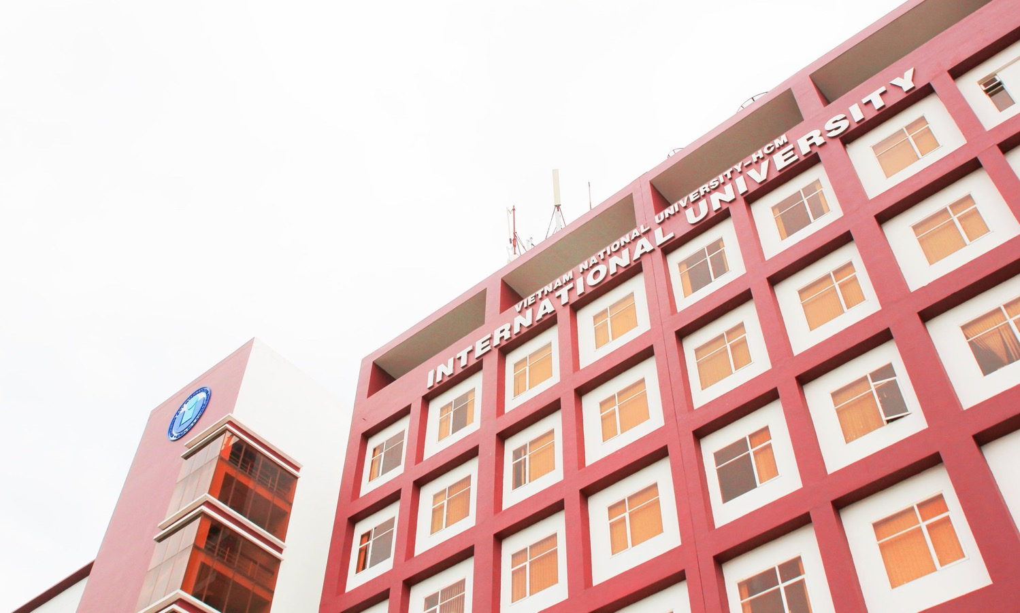
VIET NAM NATIONAL UNIVERSITY HO CHI MINH CITY
INTERNATIONAL UNIVERSITY

Slide 2
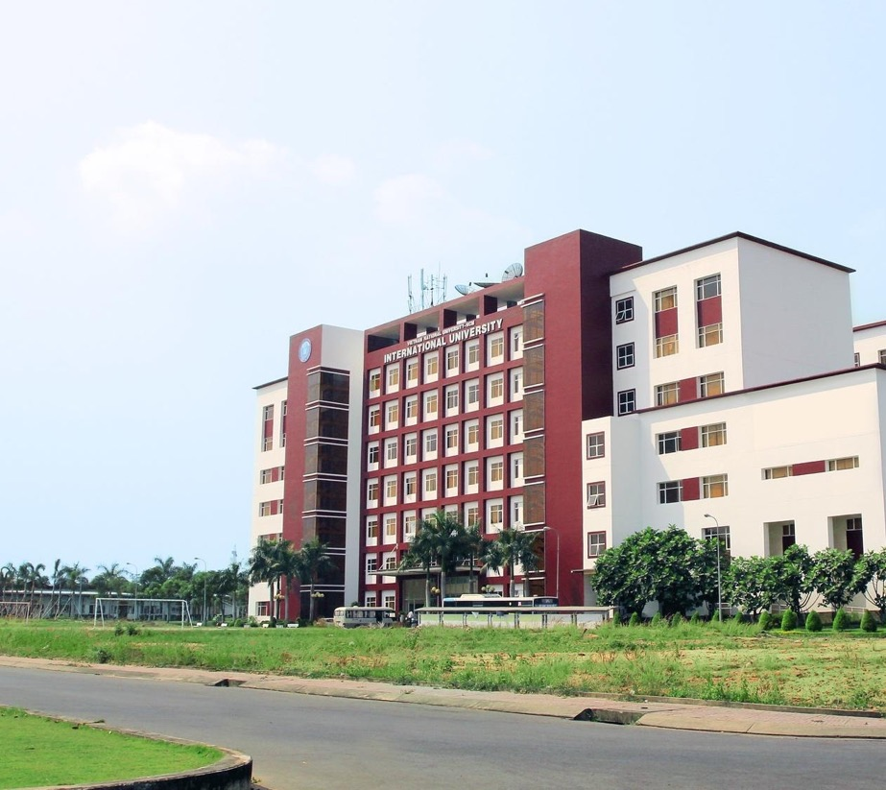
INTERNATIONAL UNIVERSITY
ESTABLISHED IN 2003
Establishment Decision No 260/2003/QD-TTg
(on December 05, 20 by Vietnam Prime Ministry)
One of VNU-HCM members
The first public English-speaking
university of Vietnam
10,540 Undergraduate students
742 Graduate students
23 Majors for Bachelor Level
12,647 Alumni
2 Kinds of Degrees
- IU-VNU Degrees
- IU’s Partners Degrees

Slide 3










UNIVERSITY OF SCIENCE
UNIVERSITY OF SOCIAL SCIENCES & HUMANITIES
UNIVERSITY
OF TECHNOLOGY
UNIVERSITY OF
INFORMATION
TECHNOLOGY
INTERNATIONAL
UNIVERSITY
AN GIANG
UNIVERSITY
UNIVERSITY OF
ECONOMICS AND LAW
UNIVERSITY OF
HEALTH SCIENCES
Center for Information Technology Development
Institute For Environment & Resources
Center for Testing & Quality Assessment
VNU-IT Park
High school for the Gifted

Slide 4

VISION
International University – Viet Nam National University Ho Chi Minh City (IU-VNU) strives to become one of the leading research – oriented universities in Vietnam and Asia, with an international, autonomous, and creative educational institution with the aim of nurturing talent and providing high quality labor for both domestic and international workforces.
VISION AND MISSION
MISSION
- To become an international higher education institution with a Vietnamese cultural identity;
- To pioneer in adopting an advanced and autonomous higher education governance model
- To offer higher education programs in a wide range of areas, all accredited by regional and international accreditation organizations;
- To enhance internationalization by using English as the medium of instruction. Students are trained to become global citizens with a high self-awareness of their social responsibility for a long-term, sustainable development;
- To pursue excellence in basic and applied research in order to meet the demand for innovative and sustainable development of industries, provinces and regions; to promote connectiveness by means of collaboration activities and social services.

Slide 5
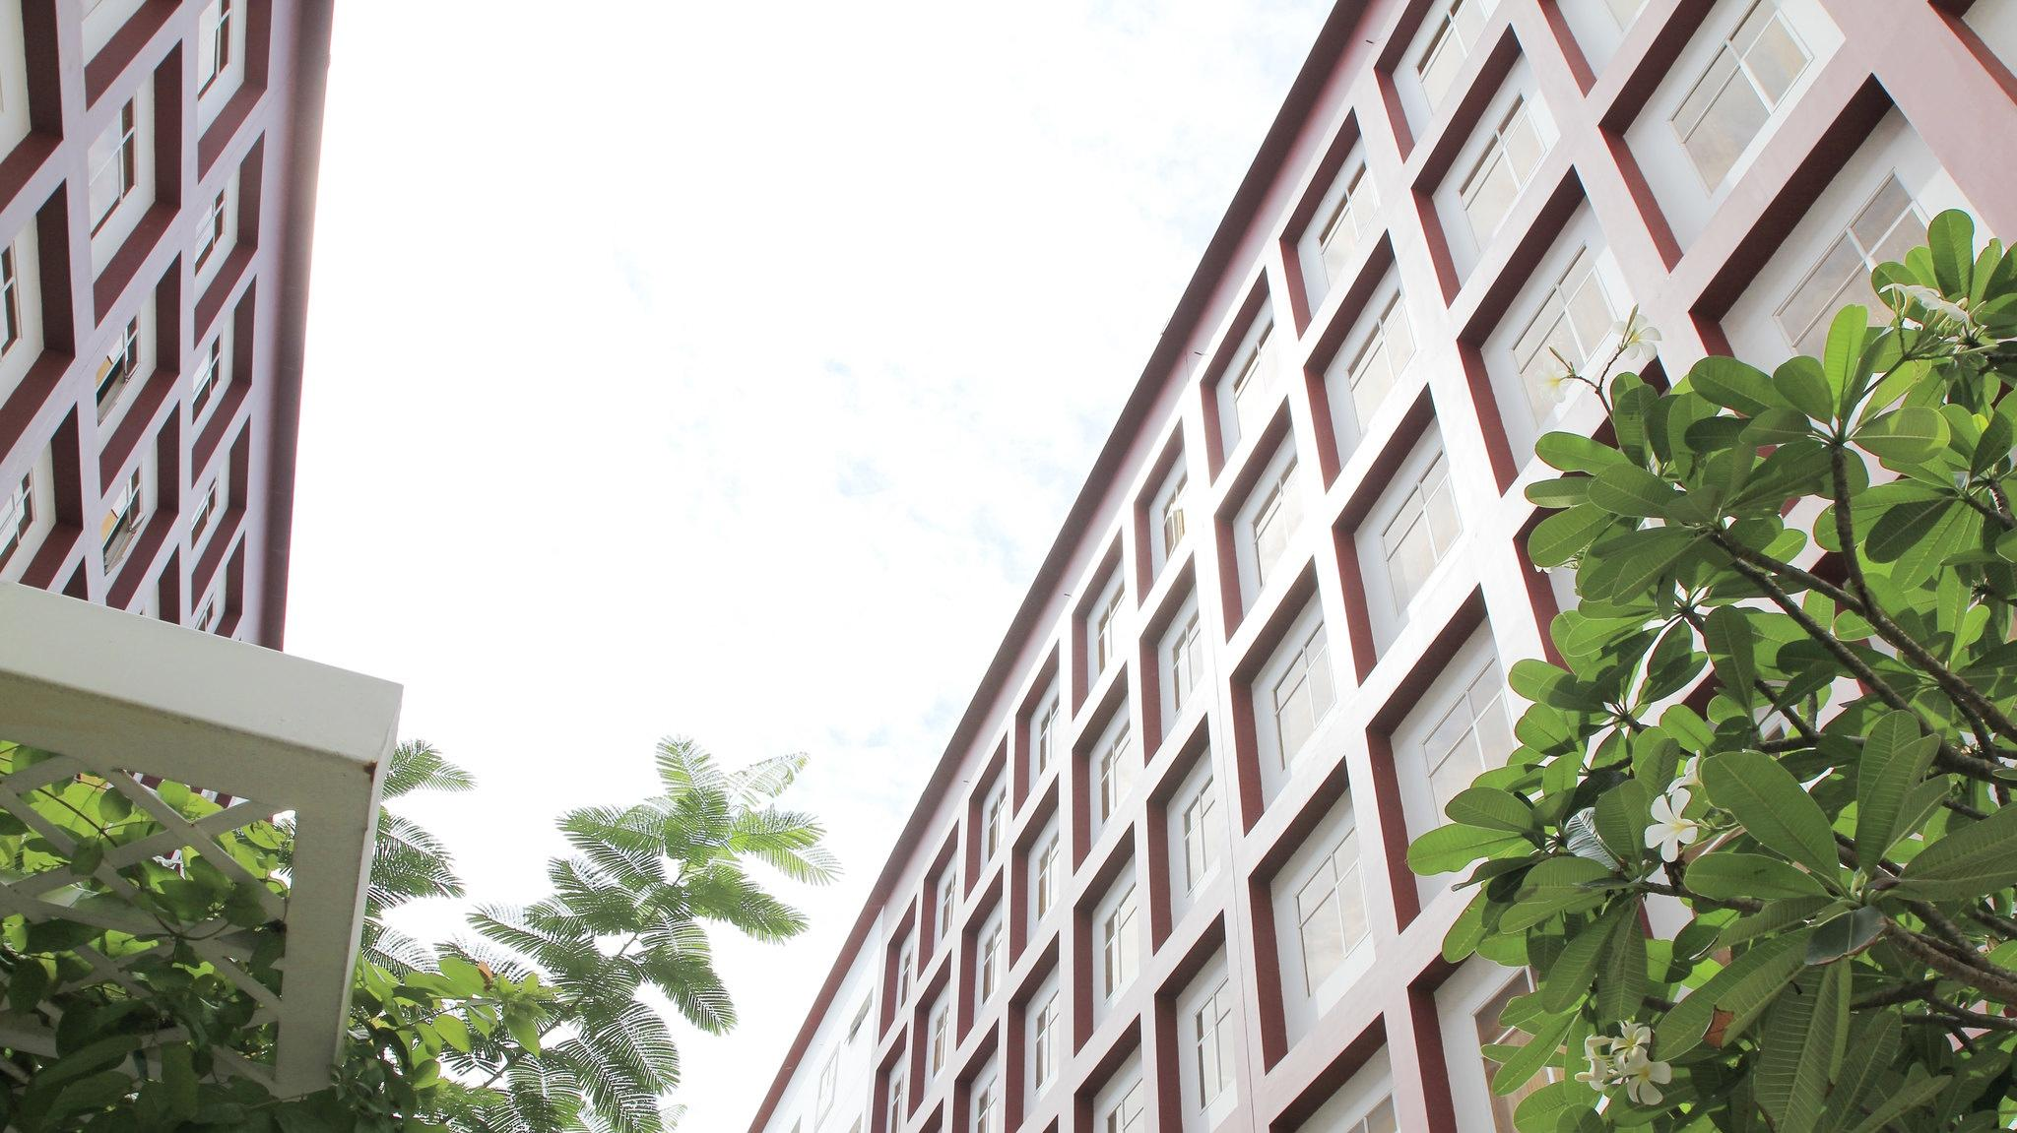
SCHOOLS AND DEPARTMENTS
SCHOOLS
1. Business
2. Computer Science and Engineering
DEPARTMENTS
3. Industrial Engineering and Management
4. Biotechnology
1. Physics
5. Biomedical Engineering
6. Electrical Engineering
2. Mathematics
7. Languages
8. Economics, Finance and Accounting
9. Chemical and Environmental Engineering
10. Civil Engineering and Management

Slide 6
PROGRAMS
BACHELOR LEVEL
1. English Linguistics and Literature
2. Business Administration
3. Finance and Banking
4. Accounting
5. Biotechnology
6. Food Technology
7. Construction Management
8. Chemistry
9. Information Technology
10. Civil Engineering
11. Electronics and Telecommunications Engineering
12. Control Engineering and Automation
13. Environmental Engineering
14. Space Engineering
15. Industrial and Systems Engineering
16. Logistics and Supply Chain Management
17. Biomedical Engineering
18. Applied Mathematics
19. Chemical Engineering
20. Data Science
21. Computer Science
22. Economics (Data Analysis in Economics)
23. Applied Statistics

Slide 7
PROGRAMS
MASTER LEVEL
Business Administration
Biotechnology
Information Technology Management
Electronics Engineering
Industrial Engineering & Management
Biomedical Engineering
Public Management
Food Technology
Logistics and Supply Chain Management
Information Technology

Slide 8
PROGRAMS
Ph.D. LEVEL
Biotechnology
Business Administration
Biomedical Engineering
Public Management
Industrial Engineering & Management

Slide 9
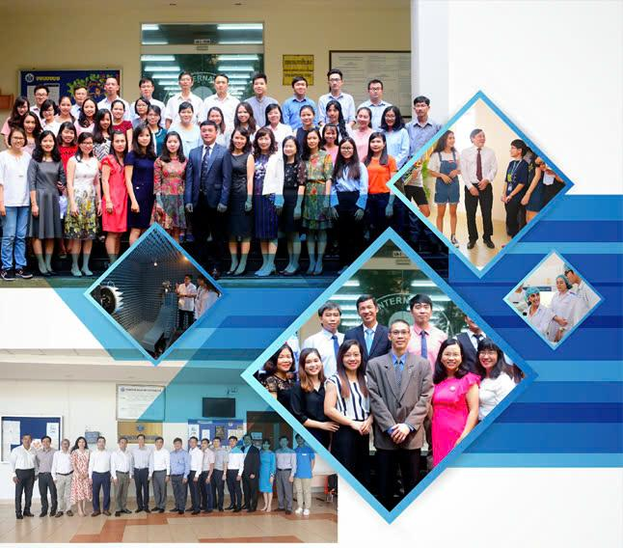
FACULTIES AND STAFF
Faculty members (full-time): 227
  3 Professors, 47 Assoc. Professors , 107 PhDs, 70 Masters
Supporting Staff: 314

Slide 10






INSTITUTIONAL ACCREDITATION
MOET (2016)
AUN-QA (2018)
ASIIN (2023)
ACCREDITATION AT PROGRAM LEVEL
02 Programs
02 Programs
02 Programs
12 Programs
01 Program
14 Programs
Notes:
At IU, we take immense pride in our recognition and credibility. We are accredited by: The Vietnamese Ministry of Education and Training (MOET) since 2016, AUN-QA (ASEAN University Network-Quality Assurance) since 2019 and ASIIN (Agency for the Accreditation of Study Programs in Engineering, Informatics, Natural Sciences, and Mathematics) since 2023.
These accreditations reflect our commitment to providing high-quality education that meets international standards. They ensure that our students receive the best opportunities for learning and development.

Slide 11












ARTICULATION PROGRAMS
29 Articulation Programs in 09 Majors
11 Partners in 05 countries

Slide 12
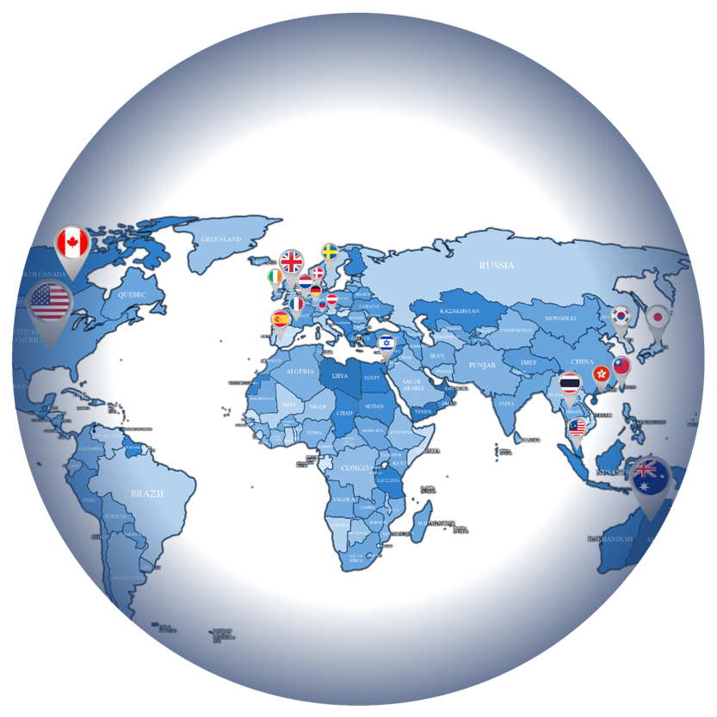
STUDENT EXCHANGE PROGRAM
WORLDWIDE
University Mobility in Asia
and the Pacific
UMAP
ACTS
ASEAN Credit Transfer
System
Outbound
84 students/year^{(*)}
Inbound
112 students/year^{(*)}
Study Tour
/Faculty-led
76 programs
2,784 participants
^{(*)} Average of last 3 years
+60 Partners
02 Exchange Organizations (UMAP, ACTS)
968,064 USD approx.
Scholarship for Exchange Program

Slide 13
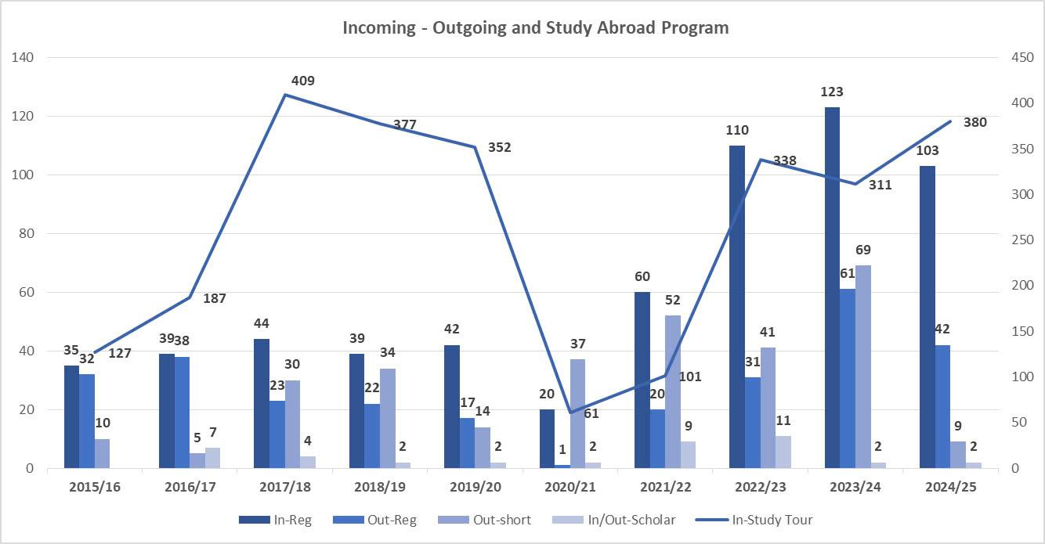

Slide 14
RESEARCH DIRECTIONS
BIOMEDICAL ENGINEERING
INDUSTRIAL ENGINEERING
& MANAGEMENT
COMPUTER SCIENCE & ENGINEERING
MATHEMATICS
BUSINESS
Medical Instrumentation
Biomedical Signal, Image Processing
Pharmaceutical Eng.
Tissue Engineering and Regenerative Medicine
Entrepreneurship in BME
Optimization and Applications: ORs, Scheduling, ...
Multiple Criteria Decision Making
Logistics and Supply Chain Management
Advanced optimization approaches in IE and SCM: datamining, AI, fuzzy, blockchain, machine learning....
Others: Simulation, Lean, Quality Management, Ergonomics, Rapid Prototyping, collaborative manufacturing
Network Management, Distributed System
Network and System Security
Computer Vision, Image Processing
Data Mining, Business Intelligence
Semantic Web, Ontology, Web Mining
Internet of Things, Mobile Computing
Software Engineering
Control theory and
systems (deterministic and
stochastic dynamical systems)
Optimization & Stochastic
processes
Partial differential equations & numerical analysis
Financial Mathematics
Machine learning
Customer behaviors, market research
Marketing strategies
Capital structure & performance
Opportunities, risks & solutions
ENVIRONMENTAL ENGINEERING
PHYSICS
CIVIL ENGINEERING
ELECTRICAL ENGINEERING
BIO-TECHNOLOGY
Environmental chemistry
Air pollution control
Application of materials (ferrate, new adsorbents) for water and wastewater treatment
Advanced oxidation processes for water and wastewater treatment
Greenhouse gas emission investigation
Galactic Astronomy | * Plasma Physics
Equipment using for low & high buildings
Advanced computing for projects designing
- Antennas and RF circuit design
- Communications in next generation networks (5G/6G)
- Machine learning and Artificial Intelligence for life
- IoT and applications
- Nonlinear System Control & Observation
- Application of Control in Power Electronics and Renewable Energy
  Biotechnology
  Food technology
  Aquatic Resource Management
  Biochemistry & medicinal chemistry

Slide 15
INTERNATIONAL PUBLICATIONS
 | 2013-2014 | 2014-2015 | 2015-2016 | 2016-2017 | 2017-2018 | 2018-2019 | 2019-2020 | 2020 - 2021 | 2021 - 2022 | 2022 - 2023
International journal articles /Ph.D. holder | 1.5 | 1.4 | 1.4 | 1.5 | 1.2 | 1.6 | 1.8 | 2.0 | 1.67 | 1.88
ISI and Scopus journal articles /Ph.D. holder | 1.0 | 0.8 | 0.7 | 0.9 | 0.7 | 1.1 | 1.4 | 1.7 | 1.38 | 1.58
Scientific papers/lecturer | 2.2 | 2.7 | 2.4 | 2.0 | 2.0 | 2.4 | 2.0 | 2.1 | 2.11 | 2.38

Slide 16

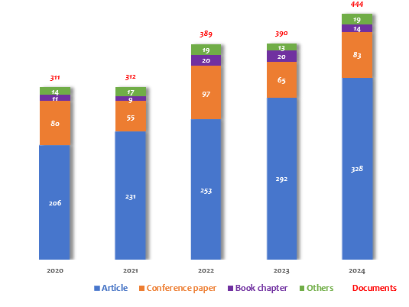

Slide 17
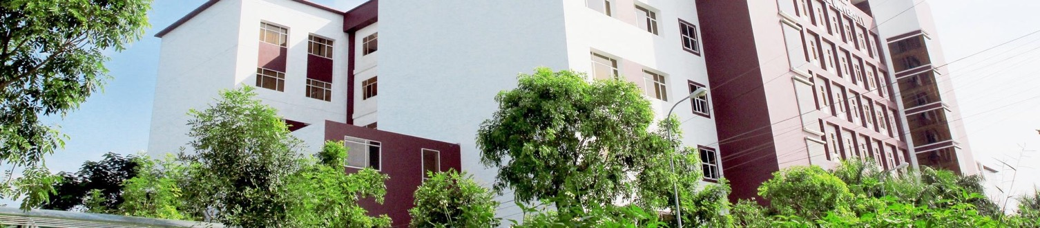
INTERNATIONAL CONFERENCES/SEMINARS
Since 2011 to now:
No. of International Conferences/ Seminars: 169
No. of participants: 12,555
RESEARCH PROJECTS
Since 2003 to now:
No. of research projects: 1,032 projects
Total funding: 261.02 billion VND

Slide 18
PROPOSED COLLABORATIONS
Collaborative training programs
Staff development (Project 89, etc.)
Joint Research Projects
Co-supervision of graduate students
International Conferences
International Projects
Mobility Programs
Credit-bearing Exchange Program/ Lab Exchange
Faculty-led Program/ Study Tour/ Hackathon...
Co-op Program/ Internship/ Work-Integrated Program
SEED Scholarship
International Competition (Sustainability, SDGs, etc.)
COIL (Collaborative Online International Learning) Program

Slide 19





THANK YOU

